Slide 1

15CSE313 Software Engineering
Lecture 9-10
Introduction to Agile
Dr C Arunkumar
Assistant Professor(Sr.Gr), Dept of Computer Science and Engg
Amrita Vishwa Vidyapeetham, Coimbatore

Slide 2
Summary
Prescriptive process models have been applied for many years in an effort to bring order and structure to software development
Each of these models suggests a somewhat different process flow, but all perform the same set of generic framework activities: communication, planning, modeling, construction, and deployment.
Sequential process models, such as the waterfall and V-models, are the oldest software engineering paradigms.
They suggest a linear process flow that is often inconsistent with modern realities (e.g., continuous change, evolving systems, tight time lines) in the software world
They do, however, have applicability in situations where requirements are well defined and stable.
Incremental process models are iterative in nature and produce working versions of software quite rapidly

Slide 3


An Introduction to Scrum
Slides Credit: MountainGoat Software
Presentation by: Mike Cohn
mike@mountaingoatsoftware.com
www.mountaingoatsoftware.com

Slide 4
Scrum in 100 words
Scrum is an agile process that allows us to focus on delivering the highest business value in the shortest time.
It allows us to rapidly and repeatedly inspect actual working software (every two weeks to one month).
The business sets the priorities. Teams self-organize to determine the best way to deliver the highest priority features.
Every two weeks to a month anyone can see real working software and decide to release it as is or continue to enhance it for another sprint

Slide 5
Scrum has been used by:
Microsoft
Yahoo
Google
Electronic Arts
High Moon Studios
Lockheed Martin
Philips
Siemens
Nokia
Capital One
BBC
Intuit
Intuit
Nielsen Media
First American Real Estate
BMC Software
Ipswitch
John Deere
Lexis Nexis
Sabre
Salesforce.com
Time Warner
Turner Broadcasting
Oce

Slide 6
Scrum has been used for:
Commercial software
In-house development
Contract development
Fixed-price projects
Financial applications
ISO 9001-certified applications
Embedded systems
24x7 systems with 99.999% uptime requirements
the Joint Strike Fighter
Video game development
FDA-approved, life-critical systems
Satellite-control software
Websites
Handheld software
Mobile phones
Network switching applications
ISV applications
Some of the largest applications in use

Slide 7
Characteristics
Self-organizing teams
Product progresses in a series of month-long “sprints”
Requirements are captured as items in a list of “product backlog”
No specific engineering practices prescribed
Uses generative rules to create an agile environment for delivering projects
One of the “agile processes”

Slide 8


The Agile Manifesto–a statement of values
Individuals and interactions
Process and tools
over
Working software
Comprehensive documentation
over
Customer collaboration
Contract negotiation
over
Responding to change
Following a plan
over
Source: www.agilemanifesto.org

Slide 9





Scrum
24 hours
Sprint
2-4 weeks
Sprint goal
Return
Sprint backlog
Potentially shippable
product increment
Return
Cancel
Gift wrap
Coupons
Gift wrap
Cancel
Coupons
Product
backlog

Slide 10
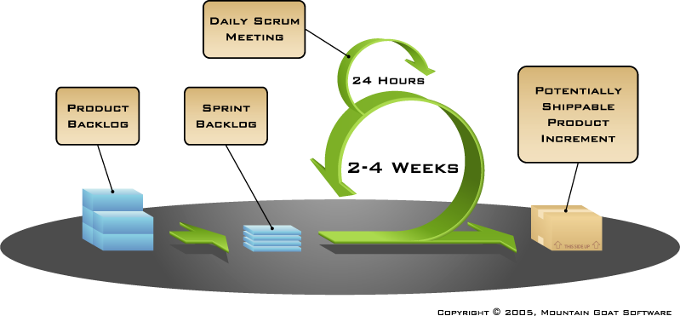
Putting it all together
Image available at www.mountaingoatsoftware.com/scrum

Slide 11
Sprints
Scrum projects make progress in a series of “sprints”
Analogous to Extreme Programming iterations
Typical duration is 2–4 weeks or a calendar month at most
A constant duration leads to a better rhythm
Product is designed, coded, and tested during the sprint

Slide 12
Sequential vs. overlapping development
Requirements
Design
Code
Test
Rather than doing all of one thing at a time...
...Scrum teams do a little of everything all the time
Source: “The New New Product Development Game” by Takeuchi and Nonaka. Harvard Business Review, January 1986.

Slide 13
No changes during a sprint
Change
Plan sprint durations around how long you can commit to keeping change out of the sprint

Slide 14
Scrum framework
Roles
Product owner
ScrumMaster
Team
Ceremonies
Sprint planning
Sprint review
Sprint retrospective
Daily scrum meeting
Artifacts
Product backlog
Sprint backlog
Burndown charts

Slide 15
First Step – Write User Stories…

Slide 16
User Stories seek to combine the strengths of written and verbal communication, where possible supported by a picture.
* Kent Beck coined the term user stories in Extreme Programming Explained 1st Edition, 1999

Slide 17
What is a User Story?
A concise, written description of a piece of functionality that will be valuable to a user (or owner) of the software.
Stories are:
User’s needs
Product descriptions
Planning items
Tokens for a conversation
Mechanisms for deferring conversation

Slide 18
User Stories
3 aspects
Written description of story used for planning/reminding
Conversations about the story that serve to fill out details
Tests that convey and document details & can be used to determine when a story is complete
Represent functionality that will be valued by users

Slide 19
Examples of specifying value to users
Good:
“A user can search for jobs”
“A company can post new jobs”
Bad:
“The software will be written in C++”
“The program will connect to the database through a connection pool”

Slide 20
Sizing stories
Too broad = impossible to test/code
Too narrow = more time spent specifying than implementing
Aim for test & code cycle of about 4 hours to 2 weeks by one or 2 programmers per story
Split long stories (“epics”) into smaller pieces
Rather than specify small details, get those in conversations with customer & annotate story
Big stories can serve as placeholders for areas of the system that still need to be discussed

Slide 21
Writing Stories
Customer writes stories
Written in language of business to allow prioritization
Customer is primary product visionary
Good stories are
Independent
Negotiable
Valuable to users or customers
Estimatable
Small
Testable (INVEST)

Slide 22
INVEST in Good User Stories
Independent – User Stories should be as independent as possible.
Negotiable – a User Story is not a contract. It is not a detailed specification. It is a reminder of features for the team to discuss and collaborate to clarify the details near the time of development.
Valuable – User Stories should be valuable to the user (or owner) of the solution. They should be written in user language. They should be features, not tasks.
Estimatable – User Stories need to be possible to estimate. They need to provide enough information to estimate, without being too detailed.
Small – User Stories should be small. Not too small and not too big.
Testable – User Stories need to be worded in a way that is testable, i.e. not too subjective and to provide clear details of how the User Story will be tested.

Slide 23
Independent
Stories that depend on other stories are difficult to prioritize and estimate
Example:
A company can pay for a job posting with a Visa card
A company can pay for a job posting with a Mastercard
A company can pay for a job posting with an American Express card

Slide 24
Negotiable
Story cards serve as reminders not contracts
Details need to be fleshed out in conversation
Story cards should have a phrase or sentence to serve as reminder to have conversation & notes about conversation

Slide 25
Valuable
Both to people using the software and paying for the software
Avoid stories valued only by developers (make the benefits to customers/users apparent for these stories)
Example
“All connections to the database are through a connection pool” could be rewritten as “Up to 50 users should be able to use the application with a 5-user database license”

Slide 26
Estimable
3 common reasons why story might not be
Developers lack domain knowledge
Get details from customer
Developers lack technical knowledge
Perform spike to explore technology
Story is too big
Split the story into smaller ones

Slide 27
Small
Easy to use in planning
Split compound & complex stories
Combine too small stories

Slide 28
Splitting Stories
Compound
Conversations may reveal multiple stories
Split along Create/Update/Delete
Split along data boundaries
Complex
Split into investigative and develop the new feature stories (define timebox for investigation)
Make sure each split-off portion is a good story (INVEST)

Slide 29
Testable
Can’t tell if story is done without tests
Aim for most tests to be automatable

Slide 30
Story Responsibilities (Developers)
Help the customers write stories that
Are promises to converse rather than detailed specs
Have value to the users or the customer
Are independent
Are testable
Are appropriately sized
Describing the need for technology/infrastructure in terms of value to users or customers
Have the conversations with the customers

Slide 31
Story Responsibilities (Customers)
Writing stories that
Are promises to converse rather than detailed specs
Have value to users or to yourself
Are independent
Are testable
Are appropriately sized
Have the conversations with the developers

Slide 32
Users
Can be more than one type of user for system
Different user types may have different roles and different stories
Disfavored users (e.g., hackers) may be included as well as favored users
Obviously, the value to users piece gets flipped for disfavored users

Slide 33
Guidelines for Good Stories
Start with goal stories
Write closed stories (stories that have a definite end point)
“A recruiter can review resumes from applicants to one of her ads” instead of “A recruiter can manage the ads she has placed”
Put constraints on the system on cards & implement automated tests for them

Slide 34
Guidelines II
Size your story appropriately for the time frame it may be implemented in
Keep the UI out as long as possible
Don’t rely solely on stories if somethings are better expressed in other ways
Include user roles in stories rather than saying “user”
Write for a single user (“A Job Seeker” not “Job Seekers”)
Use Active Voice

Slide 35
User Stories are Not
Requirements documents
Use Cases
Scenarios

Slide 36
Why do user stories?
Emphasize verbal communication
Comprehensible by everyone
Right size for planning
Work for iterative development
Encourage deferring detail
Support opportunistic development
Encourage participatory design
Build up tacit knowledge

Slide 37
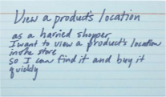
Prioritize stories in a backlog
Agile customers or product owner prioritize stories in a backlog
A collection of stories for a software product is referred to as the product backlog
The backlog is prioritized so that the most valuable items have the highest priorities

Slide 38
User Stories Summary
User Stories combine written and verbal communications, supported with a picture where possible.
User Stories should describe features that are of value to the user, written in the user’s language.
User Stories detail just enough information and no more.
Details are deferred and captured through collaboration just in time for development.
Test cases should be written before development, when the User Story is written.
User Stories should be Independent, Negotiable, Valuable, Estimatable, Small and Testable.

Slide 39
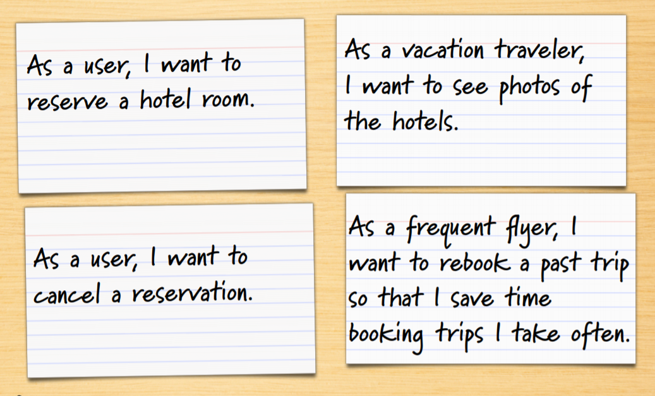
Example Travel Web Site

Slide 40
Where are the details?
As a user, I can cancel a reservation
Does the user get a full or partial refund?
Is the refund to her credit card or is it site credit?
How far ahead must the reservation be cancelled?
Is that the same for all hotels?
For all site visitors? Can frequent travelers cancel later?
Is a confirmation provided to the user?
How?

Slide 41
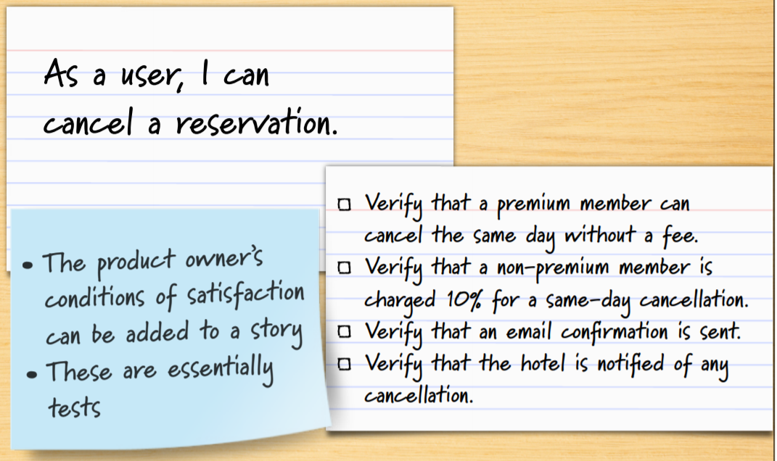
Details as conditions of satisfaction

Slide 42
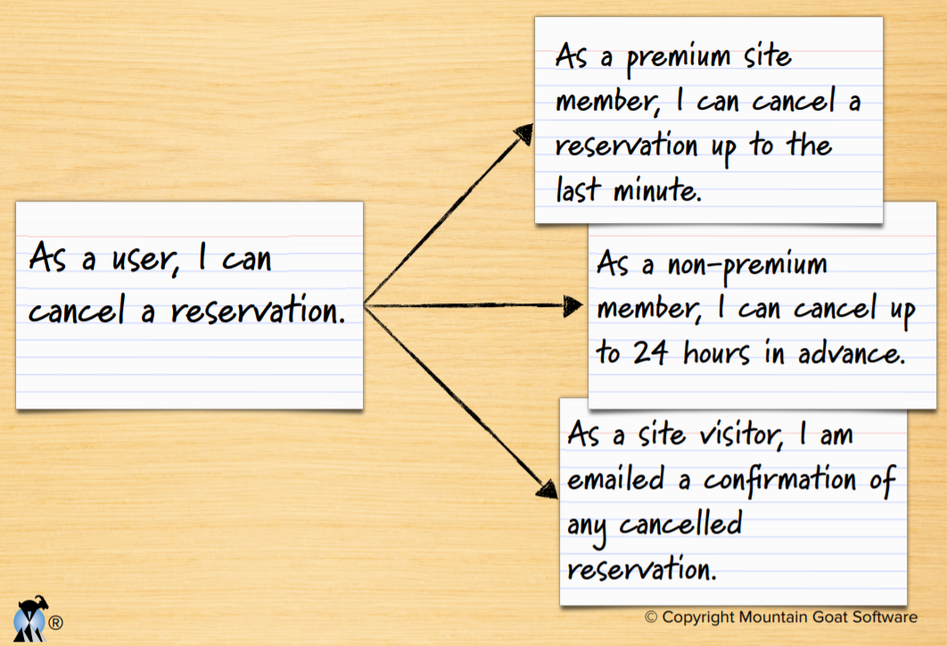
Details added in smaller sub-stories

Slide 43
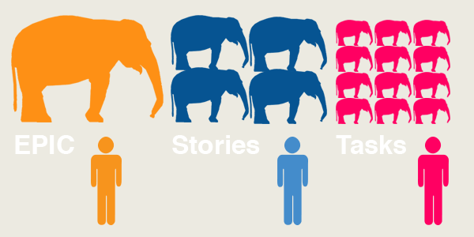
What you typically need to work on

Slide 44
User Stories identification
Project
Feature 1
Story 1
Story 2
Feature 2
Story 1
...
...
...
Feature N
Story 1
...
task 1
tast 2
...
task 1
task 2
...

Slide 45
Note
In general terms, every project will have
Epics
Features
Stories
Tasks
In this course we start from Features and ignore Epics
In other words, we use the terms Features and Epics interchangeably

Slide 46
The flow
Epic/Feature - A general use case that is a collection of user stories
User Story - A concise, written description of a piece of functionality that will be valuable to a user (or owner) of the software
Task - Represents development tasks to accomplish the user story. Generally no more than 1-day tasks.
(Engineering) Task - represents a set of engineering work that is not directly related to a user story.

Slide 47
Example
Epic/Feature: User Authentication.
User Stories:
User Login screen.
Forgot Password workflow.
Lock account after too many failed attempts.
Google login support.
Facebook login support.
Sub-Tasks:
User Login screen:
Design login page.
Cut SVG icons and images.
Implement login page HTML/CSS/JS.
Create SQL scripts to create tables.
Create SQL scripts for stored procedures.
Create web service REST API for user resource.
Hook up login page to web service REST API.
Forgot Password workflow:
...
(Engineering) Tasks:
Setup GitHub project repo.
Setup GCP (or AWS) account, containers, and services.
(There might be Sub-Tasks for these too)
...
Setup Jenkins CI pipeline.
Design overall (high-level) system architecture.
Research and decide on unit test and mocking framework.

Slide 48
References
www.mountaingoatsoftware.com/scrum
www.scrumalliance.org
www.controlchaos.com
https://www.mountaingoatsoftware.com/uploads/presentations/User-Stories-for-Agile-Requirements-Norwegian-Developers-Conference-2014.pdf

Slide 49
Scrum framework
Roles
Product owner
ScrumMaster
Team
Ceremonies
Sprint planning
Sprint review
Sprint retrospective
Daily scrum meeting
Artifacts
Product backlog
Sprint backlog
Burndown charts

Slide 50
Scrum framework
Roles
Product owner
ScrumMaster
Team
Ceremonies
Sprint planning
Sprint review
Sprint retrospective
Daily scrum meeting
Artifacts
Product backlog
Sprint backlog
Burndown charts

Slide 51

Product owner
Define the features of the product
Decide on release date and content
Be responsible for the profitability of the product (ROI)
Prioritize features according to market value
Adjust features and priority every iteration, as needed
Accept or reject work results

Slide 52

The ScrumMaster
Represents management to the project
Responsible for enacting Scrum values and practices
Removes impediments
Ensure that the team is fully functional and productive
Enable close cooperation across all roles and functions
Shield the team from external interferences

Slide 53





The team
Typically 5-9 people
Cross-functional:
Programmers, testers, user experience designers, etc.
Members should be full-time
May be exceptions (e.g., database administrator)

Slide 54
The team
Teams are self-organizing
Ideally, no titles but rarely a possibility
Membership should change only between sprints

Slide 55
Scrum framework
Roles
Product owner
ScrumMaster
Team
Ceremonies
Sprint planning
Sprint review
Sprint retrospective
Daily scrum meeting
Artifacts
Product backlog
Sprint backlog
Burndown charts

Slide 56


Team capacity
Sprint planning meeting
Sprint prioritization
Product backlog
Sprint
goal
Analyze and evaluate product backlog
Select sprint goal
Business conditions
Sprint planning
Decide how to achieve sprint goal (design)
Create sprint backlog (tasks) from product backlog items (user stories / features)
Estimate sprint backlog in hours
Current product
Sprint
backlog
Technology

Slide 57
Sprint planning
Team selects items from the product backlog they can commit to completing
Sprint backlog is created
Tasks are identified and each is estimated (1-16 hours)
Collaboratively, not done alone by the ScrumMaster
High-level design is considered
As a vacation planner, I want to see photos of the hotels.
Code the middle tier (8 hours)
Code the user interface (4)
Write test fixtures (4)
Code the foo class (6)
Update performance tests (4)

Slide 58
The daily scrum
Parameters
Daily
15-minutes
Stand-up
Not for problem solving
Whole world is invited
Only team members, ScrumMaster, product owner, can talk
Helps avoid other unnecessary meetings

Slide 59

Everyone answers 3 questions
1
What did you do yesterday?
2
What will you do today?
3
Is anything in your way?
These are not status for the ScrumMaster
They are commitments in front of peers

Slide 60
The sprint review
Team presents what it accomplished during the sprint
Typically takes the form of a demo of new features or underlying architecture
Informal
2-hour prep time rule
No slides
Whole team participates
Invite the world

Slide 61
Sprint retrospective
Periodically take a look at what is and is not working
Typically 15–30 minutes
Done after every sprint
Whole team participates
ScrumMaster
Product owner
Team
Possibly customers and others

Slide 62

Start / Stop / Continue
Whole team gathers and discusses what they’d like to:
Start doing
Stop doing
This is just one of many ways to do a sprint retrospective.
Continue doing

Slide 63
Scrum framework
Roles
Product owner
ScrumMaster
Team
Ceremonies
Sprint planning
Sprint review
Sprint retrospective
Daily scrum meeting
Artifacts
Product backlog
Sprint backlog
Burndown charts

Slide 64

Product backlog
The requirements
A list of all desired work on the project
Ideally expressed such that each item has value to the users or customers of the product
Prioritized by the product owner
Reprioritized at the start of each sprint
This is the product backlog

Slide 65
A sample product backlog
Backlog item | Estimate
Allow a guest to make a reservation | 3
As a guest, I want to cancel a reservation. | 5
As a guest, I want to change the dates of a reservation. | 3
As a hotel employee, I can run RevPAR reports (revenue-per-available-room) | 8
Improve exception handling | 8
... | 30
... | 50

Slide 66
The sprint goal
A short statement of what the work will be focused on during the sprint
Life Sciences
Support features necessary for population genetics studies.
Database Application
Make the application run on SQL Server in addition to Oracle.
Financial services
Support more technical indicators than company ABC with real-time, streaming data.

Slide 67
Managing the sprint backlog
Individuals sign up for work of their own choosing
Work is never assigned
Estimated work remaining is updated daily

Slide 68
Managing the sprint backlog
Any team member can add, delete or change the sprint backlog
Work for the sprint emerges
If work is unclear, define a sprint backlog item with a larger amount of time and break it down later
Update work remaining as more becomes known

Slide 69
A sprint backlog
Tasks
Mon
Tues
Wed
Thur
Fri
Code the user interface
8
4
8
Code the middle tier
16
12
10
4
Test the middle tier
8
16
16
11
8
Write online help
12
Write the foo class
8
8
8
8
8
Add error logging
8
4

Slide 70

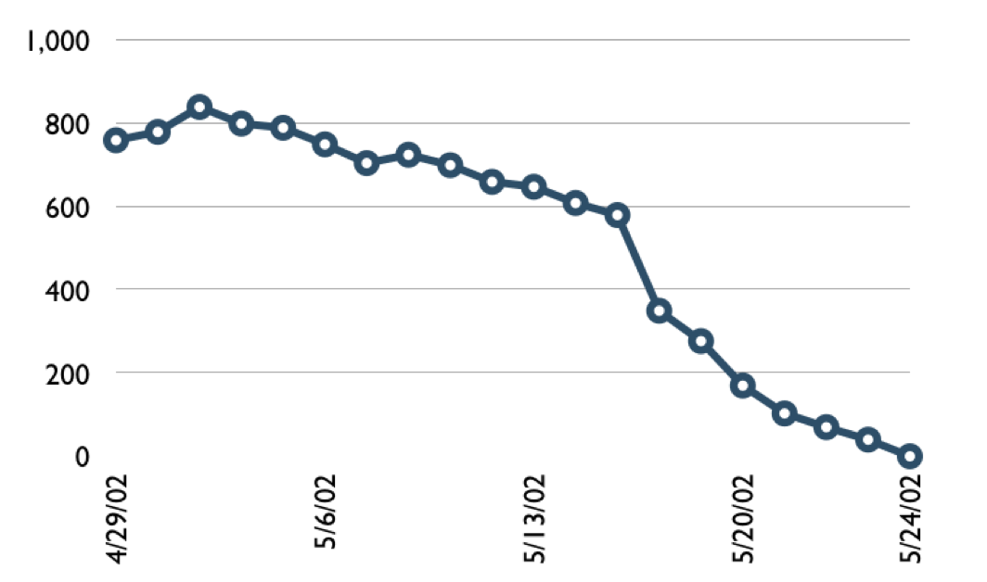
A sprint burndown chart
Hours

Slide 71
Tasks
Mon
Tues
Wed
Thur
Fri
Code the user interface
8
4
8
Code the middle tier
16
12
10
7
Test the middle tier
8
16
16
11
8
Write online help
12
50
40
30
Hours
20
10
0
Mon
Tue
Wed
Thu
Fri

Slide 72
Scalability
Typical individual team is 7 ± 2 people
Scalability comes from teams of teams
Factors in scaling
Type of application
Team size
Team dispersion
Project duration
Scrum has been used on multiple 500+ person projects

Slide 73






Scaling through the Scrum of scrums

Slide 74
Scrum of scrums of scrums

Slide 75
Where to go next
www.mountaingoatsoftware.com/scrum
www.scrumalliance.org
www.controlchaos.com
scrumdevelopment@yahoogroups.com

Slide 76
A Scrum reading list
Agile and Iterative Development: A Manager’s Guide by Craig Larman
Agile Estimating and Planning by Mike Cohn
Agile Project Management with Scrum by Ken Schwaber
Agile Retrospectives by Esther Derby and Diana Larsen

Slide 77
A Scrum reading list
Agile Software Development Ecosystems by Jim Highsmith
Agile Software Development with Scrum by Ken Schwaber and Mike Beedle
Scrum and The Enterprise by Ken Schwaber
Succeeding with Agile by Mike Cohn
User Stories Applied for Agile Software Development by Mike Cohn

